Slide 1


Congestion Control
in Data Centers (I)
H. Jonathan Chao
ECE Department
chao@nyu.edu

Slide 2
TCP in the Data Center (DC)
TCP does not meet demands of DC applications.
TCP requires large queues for high throughput. However, it
adds significant latency
wastes buffer space
performs bad with shallow-buffered switches
DC operators work around the TCP problems, by
Using Ad-hoc, inefficient, often expensive solutions, e.g., reducing Retransmission TimeOut (RTO) timer’s value, without fully understanding of consequences, tradeoffs.

Slide 3





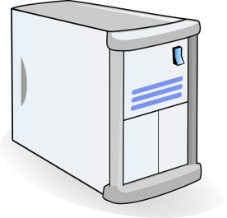

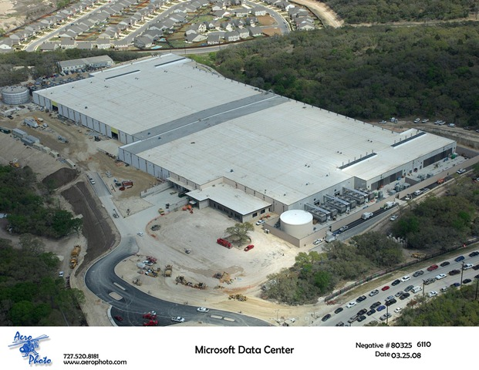










How does search work?
TLA
(Top-level Aggregator)
1.
Partition/Aggregate Application Structure
Picasso
Art is…
2. Art is a lie…
Deadline = 250ms
3.
…..
Time is money
Strict deadlines
Service-level
Agreements (SLAs)
Missed deadline
Low service quality result
Many requests per query
Tail-latency matters
Picasso
MLA
………
MLA
(Mid-level Aggregator)
1.
1. Art is a lie…
2.
Deadline = 50ms
2. The chief…
…..
3.
…..
3.
“Everything you can imagine is real.”
“Computers are useless.
They can only give you answers.”
“It is your work in life that is the ultimate seduction.“
“Bad artists copy.
Good artists steal.”
“I'd like to live as a poor man
with lots of money.“
“Art is a lie that makes us
realize the truth.
“The chief enemy of creativity is good sense.“
“Inspiration does exist,
but it must find you working.”
Deadline = 10ms
Worker Nodes
Notes:
After the animation, say “this follows what we call the partition/aggregate application structure. It’s actually quite general any time you have to do distributed lookups of large data structures to resolve queries.”
TLA: Top-level aggregators
MLA: Mid-level aggregator

Slide 4



Data Center Workloads
Partition/Aggregate
(Query)
Short messages [50KB-1MB]
(Coordination, Control state)
Large flows [1MB-100MB]
(Data update)
Bursty, Delay-sensitive
Delay-sensitive
Throughput-sensitive
Notes:
Replace PDF

Slide 5
Flow Size Distribution
> 65% of Flows are < 1MB
> 95% of Bytes from Flows > 1MB

Slide 6

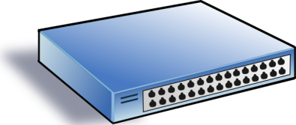
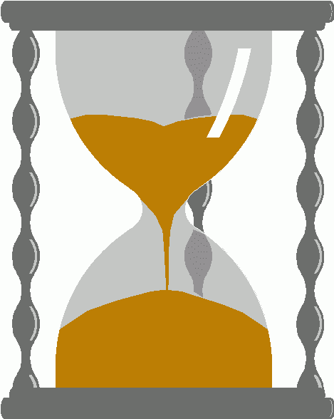
Incast meeting with shallow buffers
Synchronized fan-in congestion:
Caused by Partition/Aggregate.
Worker 1
Aggregator
Worker 2
Worker 3
RTO_{min} = 300 ms
(Retransmission TimeOut)
Worker 4
TCP timeout
Vasudevan et al. (SIGCOMM’09)

Slide 7
Queue Buildup
Sender 1
Large flows buildup queues.
Measurements in Bing cluster
For 90% packets: RTT < 1ms
For 10% packets: 1ms < RTT < 15ms
Receiver
Sender 2
Large flows result in the increase of short flows’ latency

Slide 8
Data Center Transport Requirements
High Burst Tolerance
Incast due to Partition/Aggregate is common
Low Latency
Short flows, queries
3. High Throughput
Continuous data updates, large file transfers
The challenge is to achieve these three together.

Slide 9
The TCP Control Loop with ECN Mark
Sender 1
Additive Increase:
W → W+1 per round-trip time
Multiplicative Decrease:
W → W/2 per drop or ECN mark
ECN = Explicit Congestion Notification
ECN Mark (1 bit)
Receiver
Window Size (Rate)
Time
Sender 2
Notes:
DCTCP is based on the existing Explicit Congestion Notification framework in TCP.

Slide 10
TCP Buffer Sizing & Latency
Widespread conception: increase link speed to reduce latency
Eg. upgrade from 1Gbps to 10Gbps network.
However, increasing link speed doesn’t lower queuing delay, because:
Switch buffers also need to be 10 times larger and 10 times faster.
10G x RTT
Buffer Size
1G x RTT
1G
Time
10G
Notes:
why times larger and 10 times faster?

Slide 11
DCTCP (Data Center TCP)

Slide 12
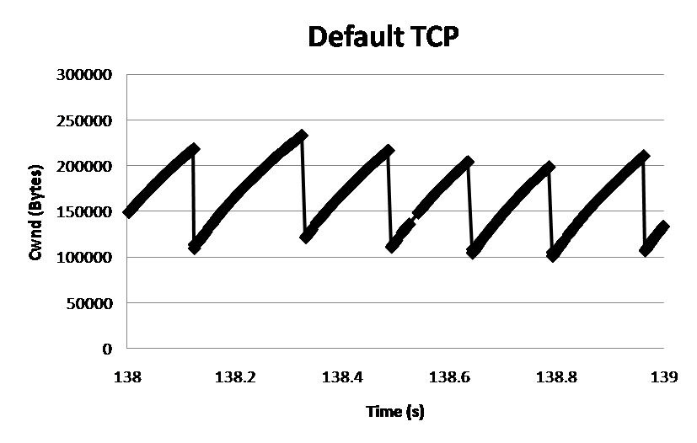
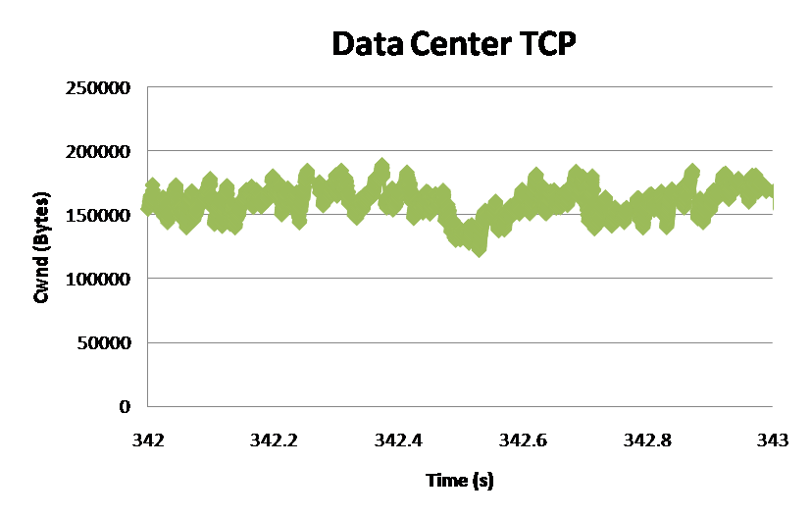
DCTCP: Main Idea
React in proportion to the extent of congestion.
Reduce window size based on fraction of marked packets.
ECN Marks | TCP | DCTCP
1 0 1 1 1 1 0 1 1 1 | Cut window by 50% | Cut window by 40%
0 0 0 0 0 0 0 0 0 1 | Cut window by 50% | Cut window by 5%
Notes:
Start with: “How can we extract multi-bit information from single-bit stream of ECN marks?”

Slide 13
DCTCP: Algorithm
B
K
Don’t
Mark
Switch side:
Mark packets when Queue Length > K.
Mark
Sender side:
Maintain running average of fraction of packets marked (α).
Adaptive window decreases:
Note: between 0 and 1
Notes:
very simple marking mechanism
not all the tunings other aqms have
on the source side, the source is trying to estimate the fraction of packets getting marked
using the obs that there is a stream of ecn marks coming back – more info in the stream than in any single bit
trying to maintain smooth rate variations to operate well even when using shallow buffers, and only a few flows (no stat mux)
F over the last RTT. In TCP there is always a way to get the next RTT from the window size. Comes from the self-clocking of TCP.
Only changing the decrease. Simplest version – makes a lot of sense. So generic could apply it to any algorithm – CTCP, CUBIC – how to cut its window leaving increase part to what it already does. Have to be careful here.

Slide 14
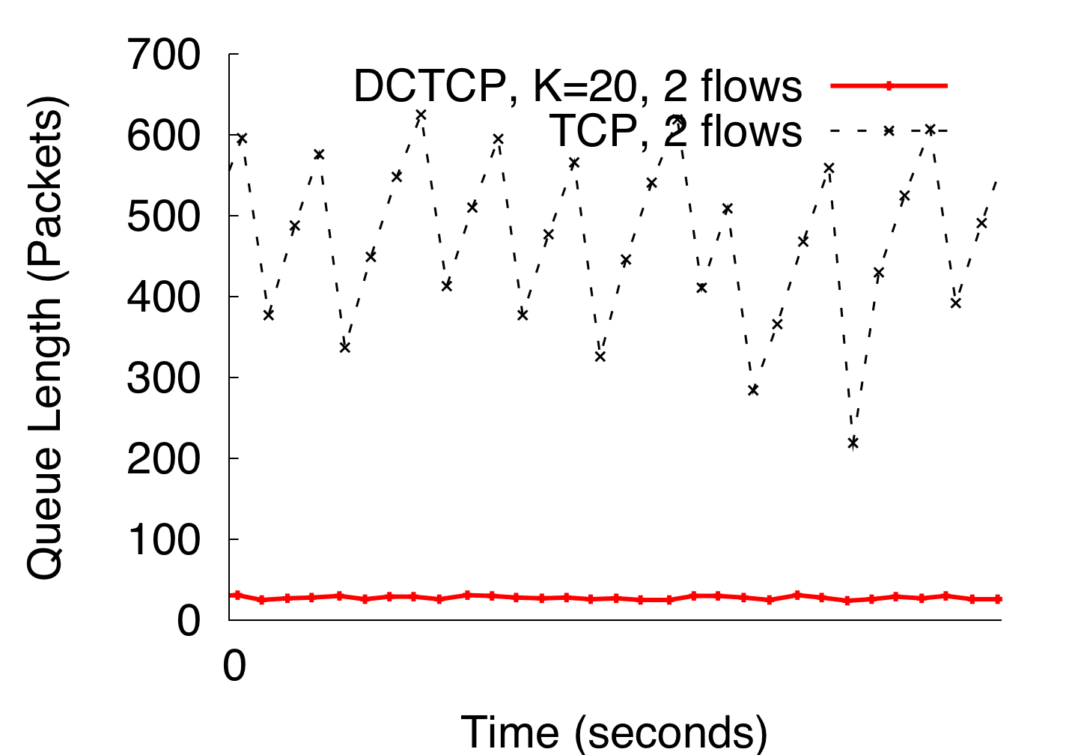
DCTCP vs TCP
(Kbytes)
Setup: Win 7, Broadcom 1Gbps Switch
Scenario: 2 long-lived flows,
ECN Marking Thresh = 30KB
(i.e., 20 * 1.5KB packets)
Notes:
Not ns2.

Slide 15
Evaluation
Implemented in Windows stack.
Real hardware, 1Gbps and 10Gbps experiments
90 server testbed
Broadcom Triumph 48 1G ports – 4MB shared memory
Cisco Cat4948 48 1G ports – 16MB shared memory
Broadcom Scorpion 24 10G ports – 4MB shared memory
Numerous micro-benchmarks
– Throughput and Queue Length
– Multi-hop
– Queue Buildup
– Buffer Pressure
Bing cluster benchmark
– Fairness and Convergence
– Incast
– Static vs Dynamic Buffer Mgmt

Slide 16
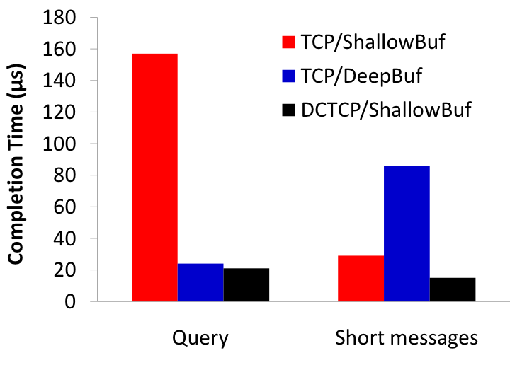
Bing Benchmark (Scaled 10x)
incast
Deep buffers fixes incast, but makes latency worse
DCTCP good for both incast & latency
Completion Time (ms)
Query Traffic
(Bursty)
Short messages
(Delay-sensitive)

Slide 17
Convergence Time
Convergence time: the time required for a new flow to grab its share of the bandwidth from an existing flow with a large window size.
DCTCP trades off convergence time because it makes more fine-grained adjustments to the window than TCP
At most ~40% more RTTs than TCP
Alizadeh et al. “Analysis of DCTCP: Stability, Convergence, and Fairness,” SIGMETRICS 2011.
Fortunately, RTT in data center is very small (e.g., hundreds of microseconds)
Intuition: DCTCP makes small multiplicative decreases, but makes them much more frequently than TCP
Notes:
In the first part of the talk, we established that what we need from DCTCP is to maintain small queues, without loss of throughput
Now in the case of TCP, the question of how much buffering is needed for high throughput has been studied and is known in the literature as the buffer sizing problem.
… and I’ll show you how to get low var…
convergence time; the time required for a new flow to
grab its share of the bandwidth from an existing flow with a
large window size.

